Slide 1
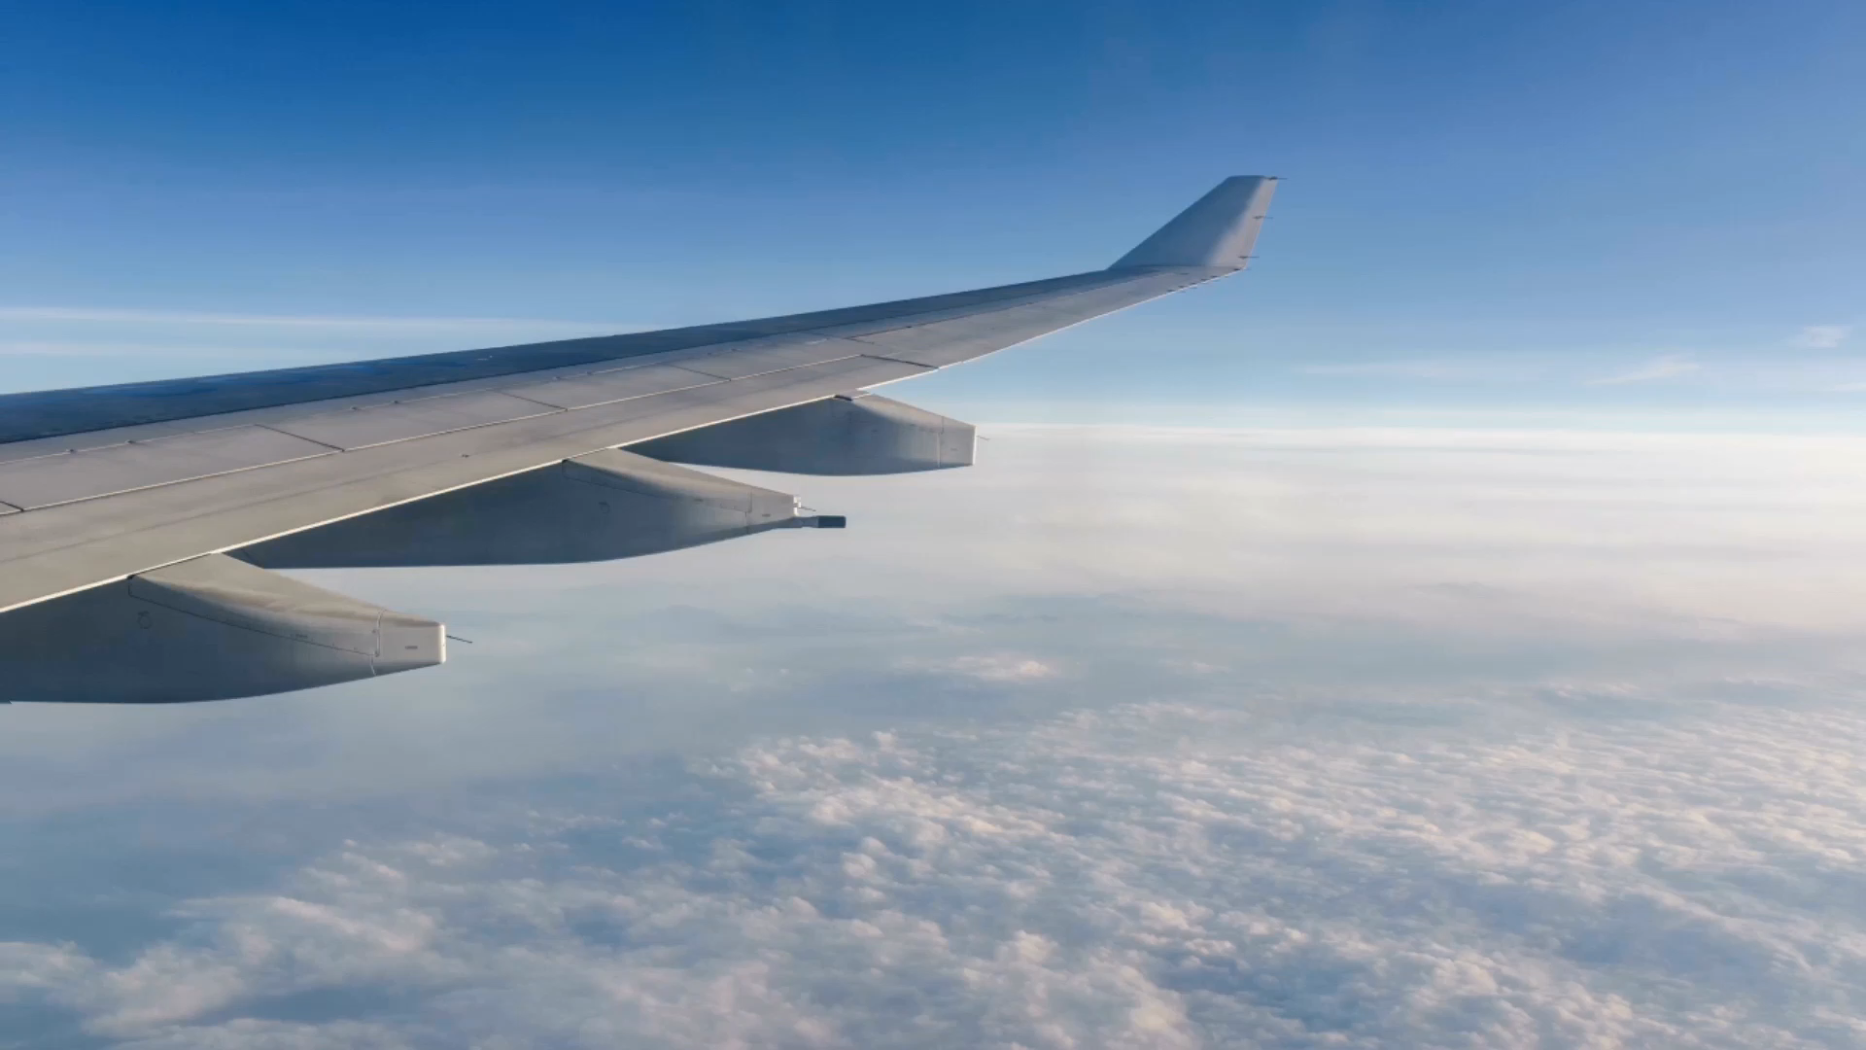
Flight Price Prediction
-Prerak Pandya

Slide 2
Problem Statement
The objective is to analyze the flight booking dataset obtained from a platform which is used to book flight tickets. A thorough study of the data will aid in the discovery of valuable insights that will be of enormous value to passengers. Apply EDA, statistical methods and Machine learning algorithms in order to get meaningful information from it.

Slide 3
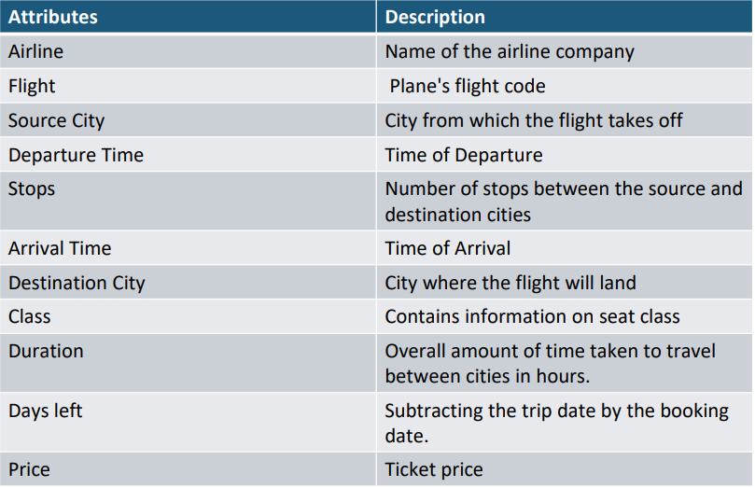
Dataset Information

Slide 4
Dataset Information

Slide 5
Important Libraries
Pandas
Numpy
Seaborn
Matplotlib
Label encoding
VIF[feature selection]
LinerRegression
Decision Tress
Randome Forest

Slide 6

Thank you
Prerak Pandya

